Slide 2
Anders Ekdahl, C.A.G Contactor
Tester, test automater since 1990 (Before that developer)
Worked in most lines of business
Contact Details
Anders Ekdahl CAG Contactor AB Tegnérlunden 3, 111 61 Stockholm +46 8 785 24 00 Mobil +46 70 514 11 13 Mail Anders.Ekdahl@cag.se Läs mer om oss på www.cag.se
Notes:
Always tried to automate my regression tests, since regression testing is boring
Defense industry, Banking, Telecom, Gaming, Governmental, Insurance, Health care, Medical

Slide 3
Cypress Workshop
Why Cypress?
Cypress vs Selenium.
First Test, walkthrough and cypress tutorial.
Exercise with walkthrough of solution.
What is Typescript and why use it?
Install Typescript for Cypress.
Page Object Modell, examples and exercise.
Data Driven Tests, walk through of example.
Dynamic Value Checking.
Notes:
The purpose of this workshop is to get you started with Cypress as a E2E testing tool
As you can see in the slide, we are going to mix walkthrough's and exercises

Slide 4
Why Cypress?
Like modern frontend frameworks, it’s based on JavaScript.
No waits.
Time travel.
Based on well known NodeJS libraries like Mocha and Chai.
It’s a complete test tool.
Notes:
Based on JavaScript, possible to use TypeScript to get better/clearer code
Cypress automatically waits for calls to finish. No need for explicit waits
In Cypress you can go back and see how a test played out, step by step.
And it’s in the NodeJS eco-system, so you can add other libraries.
No need of separate test runner, it’s a complete tool. And it’s simple to get up and running

Slide 5
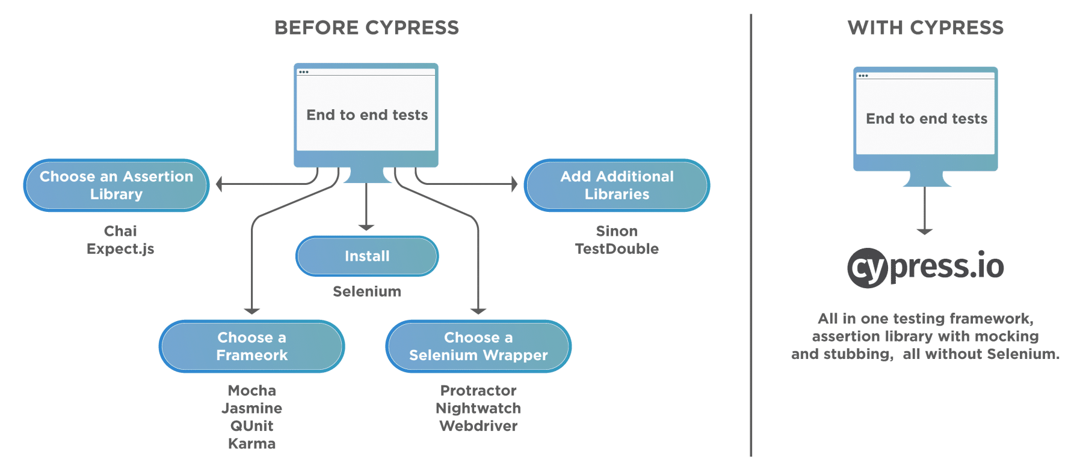
Why Cypress?
Notes:
This picture is how Cypress like to explain why it’s simpler to get started with.

Slide 6
Cypress vs Selenium
Tool | Advantages | Limitations
Cypress | Time travel No wait’s Automatic scrolling Command execution in real time Good documentation | Only one browser at the time No support for multi-tabs JavaScript (Typescript) only No Safari support Limited support for iFrames
Selenium | Compatible with multiple OS Many programming languages Supports all major browsers Provides Concise APIs Multiple tests possible | No built-in cmd for autogen. of test results Handling of Page/Element load is difficult Limited support for testing images Creating test cases is time-consuming Difficult to set up test environment as compared to Cypress
Notes:
I’ve googled some of the pros and cons of Cypress and Selenium and came up with this table.

Slide 7
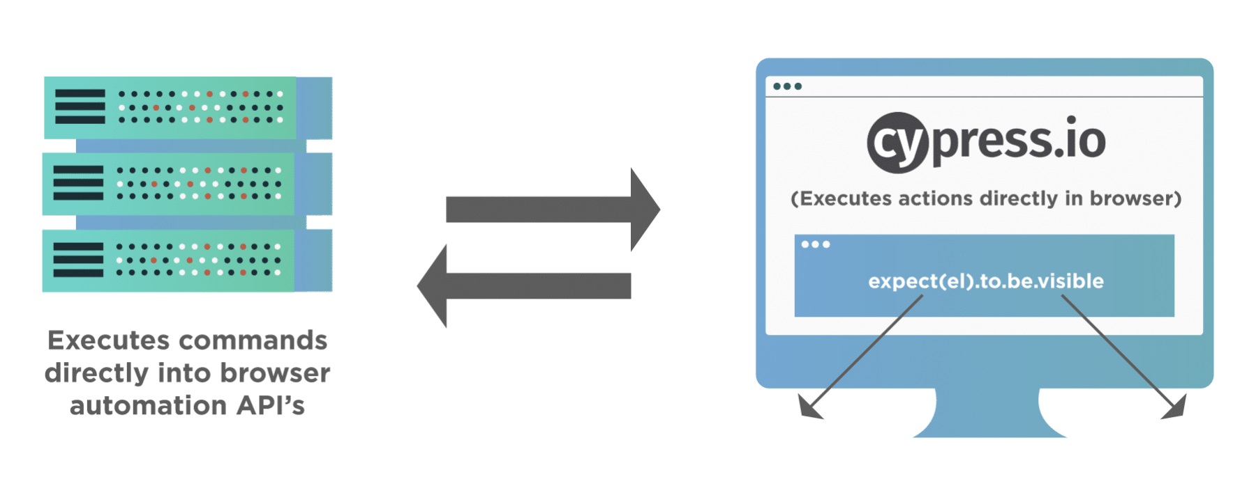
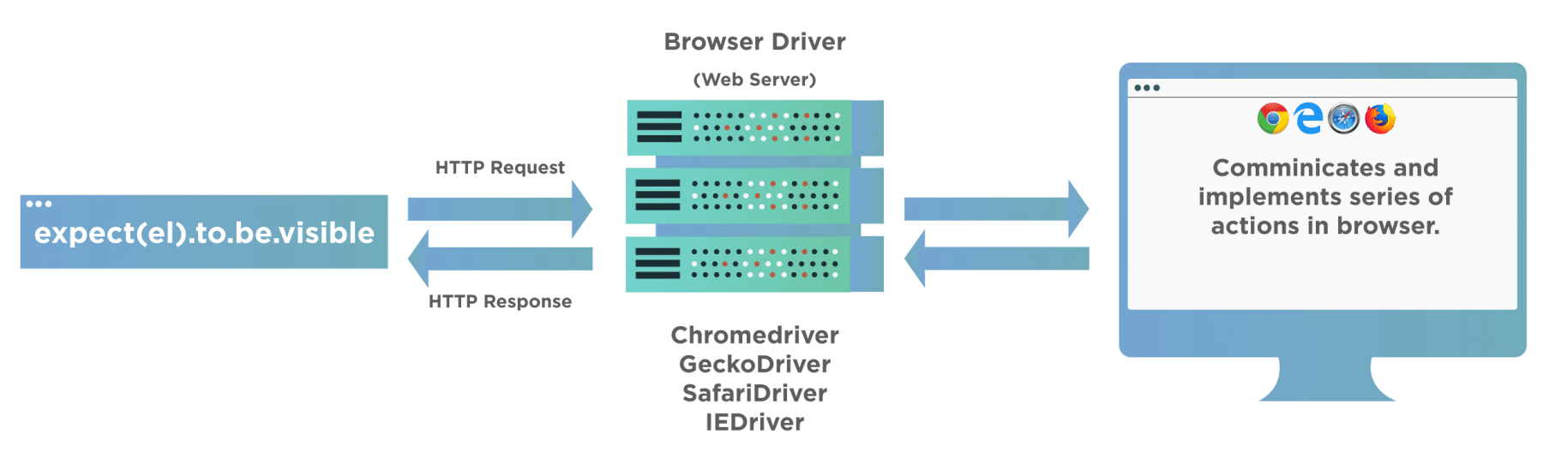
Cypress vs Selenium
Cypress | Selenium
Executes inside browser - WebSocket between tool and browser | Executes outside browser - WebDriver controls browser
Notes:
In my opinion the biggest difference is how the test code is executed.
As shown on this slide Cypress test code is executed directly in the browser, which gives us direct access to the web traffic the browser uses

Slide 8
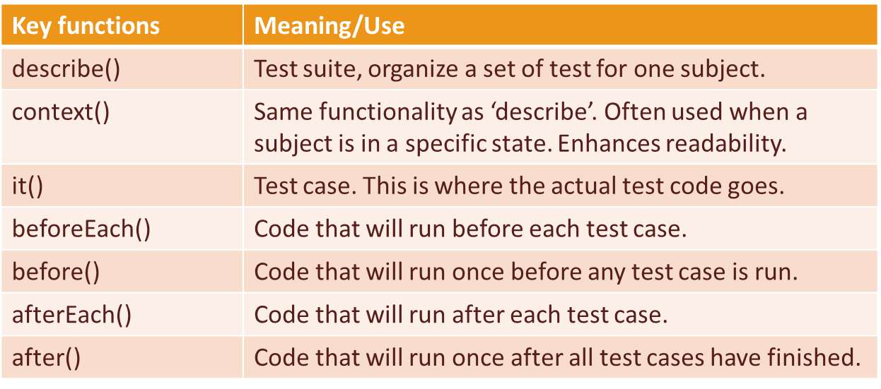
First test
Cypress come with a bundle of example tests
By default, all tests are located in /cypress/integration
Mocha test structure
Notes:
In file viewer(explorer) Show where example tests are located ./cypress/integration , open todo.js in VS and show the structure of the test-spec
What we see here is the test structure that Mocha uses, we see that it starts with then main/outer function ‘describe’, then we se a testcase in the function ‘it’
But us first have a look at the main functions in Mocha Go thru the key-words in PP.
Show the example testcase again and walk thru it – Mention nested calls.
Show element playground (ctrl-click)

Slide 9
First test
Cypress can be started from git-bash with any of:
./node_modules/.bin/cypress open
npx cypress open
npm run cyo
Goto https://docs.cypress.io/guides/getting-started/writing-your-first-test
Remember to open two git-bash, cypress app will lock one git-bash
Stop when you get to headline “Next Steps”
Example does not show you Cypress build in ‘Selector Playground’.
Notes:
So how do we run this test? Well cypress can be started in several ways
Explain the 3 cmd’s
1. Here we run the Cypress application directly by giving the relative path to it (from our ws folder)
2. In later versions of npm we can use npx, npx will automatically find our application
3. We can also define our own commands in the package.json file – show package.json
I will now start cypress and run the 1:st example:: I will now just show what it looks like when you run a test in Cypress testrunner
Show how to expand tests in the finished
Check that everyone can start cypress
<< c:a 45 min >>
I will make it simple for me and use Cypress own tutorial for writing your first test. It might be a good idea to pair up and help each other
Now everybody can start Cypress, if you haven’t already. If it’s the first time you started cypress you will get a link to the first test tutorial
Has everybody got Cypress started?
Then go a head and run thru the tutorial for writing your first test, this will take about 30 min
Ask as soon as anything seems unclear.
Show selector playground using sample_spec.js

Slide 10
Exercise 1
Create folder ‘Exercises’ in /cypress/integration/
In that folder create test specification ex1_spec.js
The test should check that David Caro is the contact person for test automation at CAG
Cag is found at url: https://www.cag.se/
One way of finding David is: Homepage -> Systemutveckling -> Mer om Test
NB! It’s tricky to check David's name. I’ll show you how, if you get stuck. Clue: Resolve promise first.

Slide 11
Solution Exercise 1
Walk thru of suggested solution
Notes:
Show good practice with simple assertions that we are on desired page
Show how we can wait for promise to finish and how we use expect in that callback for assertion
<< 45 + 30 + 5 + 20 + 10 >> -> << 110 c:a 120 2 timmar>> 09 – 11, maybe a pause after 1 hour, so we should now be at 11:15, lunch?
These first example have been written in JavaScript. JS is not a good language, in my view, to develop in.
To make developing a bit easier I always try to use TypeScript instead

Slide 12
What is TypeScript?
Wikipedia:
TypeScript is a programming language developed and maintained by Microsoft. It is a strict syntactical superset of JavaScript and adds optional static typing to the language. TypeScript is designed for the development of large applications and transcompiles to JavaScript.^{[5]} As TypeScript is a superset of JavaScript, existing JavaScript programs are also valid TypeScript programs.
Notes:
When developing auto-tests in Cypress I prefer to use TypeScript instead of JavaScript
So what is TypeScript? - Read the text
Created at Microsoft by Anders Hejlsberg (designer of C#)

Slide 13
Why TypeScript?
TypeScript is open source.
Static typing (optional)
More reliable, easier to refactor.
Better for larger/complex projects (better readability)
Cypress ships with official TypeScript declarations
Better to start with TypeScript direct.
Large JS projects can be hard to refactor to TypeScript
Notes:
I’m neither a JavaScript or Typescript developer so I will not dive down into the more technical aspects of either, but some concepts needs to be clarified
Static typing, no need to use JS linter. Can be turned of if you need to (during refactoring from JavaScript for example)
Static typing means that you have to declare your variable by type, like number or string, before you can use them
Java is a static typed language
Python is dynamically typed
Using Typescript makes it easier to structure and maintain your code
Since you get a better structure and more readable code
Cypress is ready for TypeScript
If you are thinking of using TS then start asap, as your project grows it gets harder to convert

Slide 14
Install TypeScript for Cypress
Cypress tutorial for installing TypeScript
https://docs.cypress.io/guides/tooling/typescript-support#Install-TypeScript
Get TypeScript into your project
Standing in project root folder do: npm install --save-dev typescript
Add configuration file tsconfig.json in your ./cypress folder touch ./cypress/tsconfig.json
Config on next slide
Notes:
Cypress have complete tutorial of installing TypeScript, if you’re not using VS code you will need to follow that tutorial
Others just follow the instructions in the slides or shall we do them together?

Slide 15
Install TypeScript for Cypress
Insert following in the tsconfig file: { "compilerOptions": { "target": "es5", "lib": ["es5", "dom"], "types": ["cypress"] }, "include": ["**/*.ts"] }
In your ./cypress/integration folder create empty typescript file: touch ./cypress/integration/firsts_spec.ts
Start Cypress. The ‘firsts_spec.ts’ should now be listed in the test runner
Copy content of ‘ex1_spec.js’ into ‘firsts_spec.ts’
In test runner execute firsts_spec.ts, should yield same result as .js-file
Notes:
This config tell to use the definitions that comes with cypress, adds a namespace, to avoid conflicts with other node packages
It also defines the file ending .ts, so that cypress now will recognize typescript files as valid test-specs
Now create a typescript test spec
Restart runner
Use the test you created for exercise 1, just copy the same code into the ts file
Run it and see that we get the same result, this is due to the fact that this test doesn’t contain any type declarations

Slide 16
Static vs Dynamic typing
Open both ‘ex1_spec.js’ and ‘firsts_spec.ts’ in VS Code
In ‘ex1_spec.js’ add a new testcase: it('check types in ts', () => { xx = 1 })
Now write the exact same test into your ‘firsts_spec.ts’
In your ts-file declare your variable with: Implicit declaration: let xx = 1 Explicit declaration: let xx: number = 1
I will now show you how type casting can be done
Notes:
To se that we now get type checking in ts-files, let’s compare code in written in a js file and a ts file
So in your exercise file write a meaningless testcase that uses a variable
Works fine in the js file, but in the ts file you will get a declaration error ‘name not defined’
Now declare your variable. I always use explicit declarations. This because when you start to use more complex types like classes (objects), the code get much easier to read.
Show from the example file in ./cypress/integration/solutions/firsts.ts
<< 120 + 30 = 150 min (av 300)>>

Slide 17
Page Object Model
A design pattern for auto tests of webpages.
Typically, the PO’s for a site encapsulates the actual html-pages.
Martin Fowler have (in my opinion) a good explanation of PO: https://martinfowler.com/bliki/PageObject.html
Notes:
When designing auto-tests in a larger scale it’s good practice to think about how you will organize your code
One thing we want to do is to separate our element locators and our code. We also want code easy to maintain/refactor, so commonly used functions should be in one place and not in all the test-specs.
A common way to help you to this is to use the PO model
Can be used by developers of webpages as well
The simplest way of thinking of a PO is that it will abstract a webpage, so that the PO will have attributes like the page url and methods like clickToNextPage()
Martin Fowler have one explanation of PO, but there exists many more ofc

Slide 18
Page Objects, Example Parent Page
The Task: Check contact person for business areas ‘Integration’, ‘Java’ and ‘Testautomation’ in ‘Systemutveckling’ main area.
Separate code from tests, create folder ‘pageobjects’ in ./cypress folder
Let’s have a look at CAG website.
4 different main areas. In our task we are only concerned in 1, ‘Systemutveckling’
In your ‘pageobjects’ folder create file ‘cag_po.ts’
Now I will walk you through creation of the parent page.
Notes:
There exists a lot of theoretical opinions and ideas about PO.
But I think it’s better to create your own opinion on them, so let’s make an example together.
Let’s use CAG website, since we already written test for it
The test task is to check the contact person for all areas in system development
Start by creating a place to put our page objects
I find it often useful to create one ‘parent’-page and then let other pages inherit from that page On CAG first page we see 4 areas, we will only test one of them, Systemutveckling. BUT to make the parent-page more future proof let’s look in the other areas as well All but Utbildning have contacs, so it seems a good ide to have a function to retrieve contact person in the parent page
ME: Open VS Code and walk thru cag_po.ts – tell all to create code at the same time OR simply copy cag_po.ts???

Slide 19
Page Objects, Child Pages
Now let’s create our first child page object, cag_home_po.ts.
Create first test-spec to see how PO’s will be utilized. ./cypress/integration/checkPO_spec.ts
Tests in PO or not?
Separation of responsibilities – so no tests in PO
Let’s create our 2:nd child page to encapsulate the ‘Systemutveckling’ page. ./cypress/pageobjects/cag_sysutv_po.ts
Notes:
Open VS Code and walk thru cag_home_po.ts, this is at first very simple.
But I will show that inheritance works in testscript before adding more functionality to sysutv.
Should we have the tests/assertions in the PO’s? Martin Fowler thinks not and I tend to agree with him. But the PO’s gets a bit more complex if we don’t do assertions in them
Show that a simple return won’t work -> undefined
Show assertion in PO
Walkthru cag_sysutv_po.ts + the tests in checkPO_spec.ts – show polymorphism
<< 150 + 30 = 180 min (av 300)>>

Slide 20
Exercise 2
Copy and rename ./cypress/integration/Solutions/checkPO.ts to: ./cypress/integration/Exercises/ex2_spec.ts
In ex2_spec.ts first correct the errors in the imports. Then Continue with implementing the stubbed tests.
The task is to check that it’s the correct contact person for the specified business areas in ‘Systemutveckling’.
Areas ‘Integration’, ‘Java’ and ‘Testautomation’.
Notes:
So now it’s time for our 2:ns exercise

Slide 21
Solution Exercise 2
Walk thru of suggested solution.
Did we fullfill our task?
Walk thru of simplified solution.
What about correct info and testdata?
Notes:
Show good practice with simple assertions that we are on desired page, Show how we can wait for promise to finish and how we use expect in that callback for assertion
Task accomplished? Yes and No
We test more than the task suggests. To be able to maintain your tests it’s good practice to keep tests of business rules atomic (1 rule in one test), so better with many small tests. Then again depending on your product and your developers some extra assertions might be of value.
So we might remove the tests of correct title, since it’s not in our scope
We also test that traversing from home page to the pages in ‘systemutveckling’ is working, this is nor in the BR
Walk thru ex2_simple_spec.ts
In this simplified solution we still have hardcode the correct answers, our test data, into the test-spec. This is generally bad practice since we don’t want to update our tests when test data changes. So this leads us into how test data and data driven tests can be achieved in Cypress. uri
uri
<< 180 + 90 = 270 min (av 300)>>

Slide 22
Data Driven Tests
Why DDT?
Same logic with many boundary or partitioning values.
Separate test data from tests (code).
Make automated tests easier to maintain.
Notes:
Why DDT.
If same tests must be run many times due to for example boundary value or equivalence partitioning testing (or combinatoric tests OS+Webbrowser+version)
By separating test data from code, tests will be easier to explain. Showing for example test data in a structured way, like in excel table or json-tree makes it is easier for PO to understand what is tested
For the same reason tests will be easier to maintain, if for example a new item is added in a webstore. All we must do is to add the new products characteristic to our test data

Slide 23
Data Driven Tests
Cypress handles fixed (test) data in fixtures.
A fixture is a json-file encapsulating the data your tests need.
Fixture files are placed in ./cypress/fixtures.
They are loaded in your tests with command cy.fixture(filePath).
Walk through of example, using our previous contact check.
Simplify our tests - ./cypress/integration/solutions/exercises/ex2_simple1_spec.ts
Make them data driven - ./cypress/integration/solutions/exercises/ex2_dd1_spec.ts
Our testdata - ./cypress/fixtures/sysutvcontacts.json
Notes:
DDT in Cypress, Default cypress will store fixed test data in fixture files
A fixture file is a json file,
Show folder ./cypress/fixtures
Using cmd cy.fixture
I will now walk you thru an example of how our previous contact check could look like when you make it data-driven
First let’s simplify our test. The task was to check contact person in 3 business areas in systemutveckling. So we actually don’t have to check that the traversal to each BA-page is working, we can go directly to them using their URI instead. In fact this is best practice. Separate tests to have single responsibility as much as possible, makes test easier to maintain when requirements changes Show ./cypress/integration/solutions/exercises/ex2_simple1_spec.ts and run it
So let’s Make test DD, show ex2_dd1_spec.ts, go thru it and run it
Lets look in the json file, here we the attributes we have in our datadesc-class, so if we change info for any of our contacs all we have to do is change data here and test will run ok again Let change data just to see that test fails
<< 270 + 30 = 300 min (av 300)>>

Slide 24
Dynamic value checking
Checking value changes on a subject
For example, total price in cart when adding a new item
Best shown in following example
https://www.saucedemo.com/
Notes:
Since we are coding in JavaScript there are some pitfalls when checking web gui’s. One is checking value changes
Run swag1 and walk thru it First show the page saucedemo. Show that we log value with 1 item then we add another item and log total price with both 1 and 2 items But when we come to our assertion we can see that both values are zero Why is this? Anyone? I’m not 100% sure, but as I get it it’s a question of timing, The test script will run sequentially very fast. But we must catch our values in callbacks when the values are ready from webpage, this means that we get the values after the test-script has finished running So the values at the end of the test-script are correctly zero. If we set some values initially on the 2 global variables we will see that these initial values will be logged Set values to the variables 1 to 1 and 2 to 2, enable assertion and then run test again Can you see the danger here? – This test will always succeed, so what must we do to test our tests? – Make them fail in a controlled fashion
So how do we make this work? fortunately I have made an example of this too –show swag2 Here I have put all common code in separate functions, so that the actual testing code get clearer Show test, explain/show that we use alias here (.as())
Don’t mention cy.wait(), since I’m not 100% clear why that won’t work

Slide 25
BDD, TDD, etc. are not testing. They discourage imaginative critical thinking, which is the hallmark of genuine testing. They are shallow, algorithmically-driven checking processes. I am not criticizing them as development practices. But to call them testing has done tremendous damage to the testing field. Really, the whole idea of testing professionalism has gotten derailed by programmers who confuse the creative process of testing with algorithmic output checking. Yes, testing— real testing— can be integrated with Agile. It involves inviting people in who focus on finding problems, rather than using mere positive thinking and “collaboration!” and emoji magic to get us to a good release.
“James Bach”

Slide 26
Cypress Configuration
Cypress default settings are defined in the file ./cypress.json
The file is created when running Cypress first time
The file is initially empty, so it’s used to change standard default settings
There are many settings you can change, read more on: https://docs.cypress.io/guides/references/configuration#cypress-json
Set web browser window size: { "viewportWidth": 1200, "viewportHeight": 1000}
Can also be set with command (in code): cy.viewport()
Help on Cypress commands can be accessed with: https://docs.cypress.io/api/commands/viewport
Change size of chrome window by adding setting to file: ./cypress/plugins/index.js
Copy ./workshop/cypress-plugin-index.js to ./cypress/plugins/index.js
Notes:
Before the first exercise I will show shortly how you can change configuration of cypress
There exists many things you that you can change, but I will only show viewport and chrome window size.
To change/set default values Cypress reads the file cypress.json, located in your projects root folder
To create consistent tests it can be good to set the viewport of tested browset. Whatever size the physical window on screen have Cypress will always maintain the ordered viewport size
Viewport have a lot of predefined settings, like ‘iphone6’,
To change the chrome window size in your cypress execution browser you need to add setting to ./cypress/plugins/index.js file, just copy file from workshop folder, then set size for chrome to your wished size
Restart and check that your changes are in effect

